Slide 1
Software Engineering
Chapter 4
Requirements Engineering – Use Cases
Objectives
  Be able to define requirements engineering
  Be able to write verifiable functional and non-functional requirements
  Be able to create UML use-case diagrams & descriptions
Text: Priestley Chapter 4 & 5
Bruegge & Dutoit, Chapter 4
Sommerville Chapters 6-8

Slide 2
Gathering Requirements
Many different perspectives
Required
System
…etc.
Manager
Purchaser
Administrator
Operator
Director

Slide 3
Requirements Engineering
The process of establishing the services that the customer requires from a system and the constraints under which it operates and is developed
What is a requirement?
  A requirement is a feature that a system must have or a constraint that it must satisfy to be accepted by the client
  It may range from a high-level abstract statement of a service or of a system constraint to a detailed mathematical functional specification
Requirements Engineering has 2 main activities
  Requirements Elicitation
  Requirements Analysis

Slide 4
Requirements elicitation is difficult – why?

Slide 5
Requirements elicitation - difficult
Requires collaboration between domain experts and technical experts
  Developers, clients, users
Hard to anticipate the effects that the new system will have on the organisation
Different users have different requirements and priorities
System end-users and organisations who pay for the system have different requirements
Natural language problems

Slide 6
How are requirements elicited?
Interviews
  Allow detailed, first-hand information gathering
  Expensive
Questionnaires
  Good if many people involved ,especially if dispersed
  Tend to have poor responses
Observation
  Accurate if done well: see what clients are actually doing
  Expensive
Joint Application Design
  Workshops with clients facilitate consensus on requirements
  Meetings may mean clients are away from their workspace

Slide 7
Typical Requirements Elicitation Process
Identify actors
  types of user (including other systems) who interact with the system
Identify scenarios
  concrete examples of how the system will be used
  Used to communicate with users about the requirements for the system
Identify use cases
  Description of all possible behaviour in the system
  These are abstractions unlike scenarios which are specific examples
Refine use cases
  Ensure completeness including exceptions/error paths
Identify Relationships among use cases
  Factor out common functionality
  Find dependencies (more later on this)
Identify Non-functional requirements

Slide 8
Requirements Definition/Specification
Traditionally there are two types of document
Requirements definition
  A statement in natural language plus diagrams of the services the system provides and its operational constraints. Written for customers
Requirements specification
  A structured document setting out detailed descriptions of the system services. Written as a contract between client and contractor. For customers + developers

Slide 9
Requirements Documents
Many different approaches
Typically grouped by feature
Requirements Definition describes requirements at a high level
Requirements Specification gives the details for each function
  Name
  Pre-conditions
  Inputs
  Source
  Function description
  Outputs
  Post conditions
Look up the IEEE Requirements standard (http://ieeexplore.ieee.org/iel4/5841/15571/00720574.pdf )
We will assume use cases + UML design diagrams

Slide 10
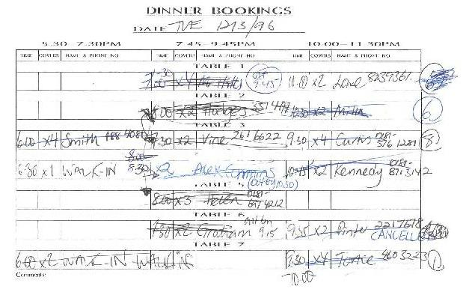
Use case example - Restaurant
GOAL: Support day to day reservations operations of a restaurant
ACTIVITIES
  Currently a manual operation is used
  Sheet with rows – one row per table
  Number of diners added to the row
  Restaurant has 3 sittings in the evening
  i.e. 3 per table = ‘pre-theatre’, ‘dinner’,
  ‘supper’
    Bookings can span between these slots
    Contact name + phone number added with each booking
  As each party arrives – the booking is crossed out
  If the party is moved to a different table an arrow is drawn to the new location
  Various other notes are scribbled on – e.g. “table must be vacated by 9pm”
  Diners can walk in too: “walk in” added to the sheet

Slide 11
Need for computer support?
What are the problems with the current system
Suppose you have to produce a first Iteration – what should be in it? What will you postpone?

Slide 12
Need for computer support?
Problems
  Slow
  Messy
  Mistakes
  are often made
First Iteration
  Deliver just enough functionality to be useful
  Record bookings and update them as needed

Slide 13

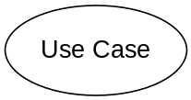
UML – Use Case Modelling
Use cases describe system behaviour that is visible to a user or to another system
Use cases are initiated by users or systems called actors
An actor represents anything that needs to interact with the system to exchange information – it may be a role a user plays or another system
Each use case is a significant set of sequences of interaction between the actor and the system: it yields an observable result of value to the actor
Use case diagrams represent an overview of the actors of the system and the behaviour that the system provides for them
The actor initiates system activity, a use case, for the purposes of completing some task
If an external party initiates the input, it is considered an actor
  Potential human users of the system, identify their roles
  Interactions with external systems
NB: Use Cases DO NOT describe the internal details of the software system
  … though they are likely to influence the form it eventually takes
  They impose constraints on designers who have to meet their functionality

Slide 14
Use Cases
Restaurant booking system – 4 use cases
These are all things the system should do for a particular user
  Use case describes a self-contained task that a user would recognise as part of their job
Who are the actors here? (i.e. roles played)

Slide 15
Use Cases
Restaurant booking system – 4 use cases
  Record information about a new booking (“Record Booking”)
  Cancel a booking (“Cancel Booking”)
  Record the arrival of a customer (“Record Arrival”)
  Move a customer from one table to another (“Table Transfer”)
These are all things the system should do for a particular user
  Use case describes a self-contained task that a user would recognise as part of their job
Who are the actors here? (i.e. roles played)
  Receptionist
  Head Waiter

Slide 16
Initial Use Case Diagram
Actors: users need not be 1:1
  Receptionist & Head Waiter may be same person
Stick person = actor
Line = association

Slide 17
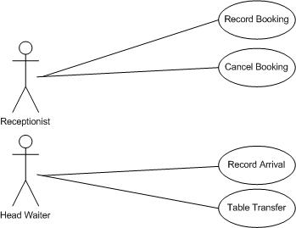
Initial Use Case Diagram
Actors: users need not be 1:1
  Receptionist & Head Waiter may be same person
Stick person = actor
Line = association

Slide 18
Describing use cases
Need to describe the course of events
  Need to cover all possible events - especially where things can go wrong
    E.g. table not available at the time a customer had requested
  The UML does not define a standard way to describe use cases in text-form
  Template:
    Name (short verb phrase)
    Summary (description)
    Actors (state the primary actor - is the one who initiates the use case
    plus all others involved)
    Triggers – events that start the use case
    Pre-conditions – must be true before the use case can start
    Post conditions – will be true after the use case has finished
      Minimal Guarantees (all cases)
      Success Guarantees (normally)
    Flow of events (numbered)
    Alternative or exceptional flow of events – usually “At [point number ] x …”
    Extension Points – where another use case can take over
    Inclusions – summarises use cases that are included in this one

Slide 19
Restaurant: Record Booking Use Case
Flow of events
  The receptionist enters the date of the requested reservations
  The system displays the bookings for that date
  The receptionist enters the customer name and phone number, the time of booking, the number of covers and the table number
  The system records and displays the new booking
Alternative Flow
  At 2, there is no table available, the use case terminates
  (Note – in a future iteration we might add some functionality – such as putting on a waiting list)

Slide 20
Restaurant Use Cases: Record Arrival
Flow of events
Alternative Flow

Slide 21
Restaurant Use Cases: Record Arrival
Flow of events
  The head waiter enters the current date
  The system displays the bookings for that date
  The head waiter confirms arrival for a selected booking
  The system records this and updates the display, marking customer as having arrived
Alternative Flow
  At 3 – there is no booking for that customer
  The head waiter creates a ‘walk in’ booking by entering the time, the number of covers and the table number
  The system records and displays the new booking

Slide 22
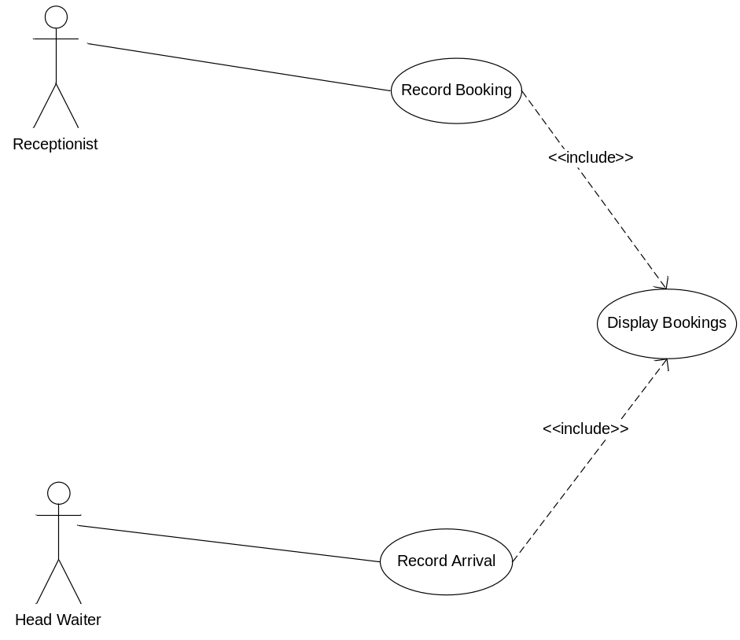
Use case inclusion
Where 2 use cases have shared behaviour – use inclusion
New Flow of events for Record Booking
  The receptionist performs the ‘Display bookings’ use case – may be written as:
  include(Display Bookings) or
  include ‘Display Bookings’
  The receptionist enters the customer name and phone number, the time of booking, the number of covers and the table number
  The system records and displays the new booking

Slide 23
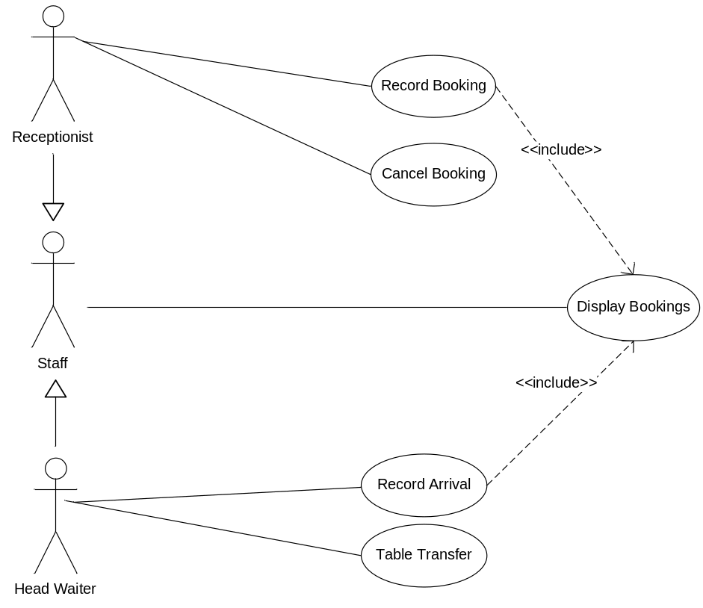
Actor generalization
Above – the Receptionist and the Head Waiter both can call the use case “Display Bookings”
To simplify – introduce a generalised “Staff” Actor
Thus
  Receptionist is a specialization of Staff
  Head Waiter is a specialization of Staff
(The use case model isn’t finished yet: there will be more
include and extend relationships
to add!)

Slide 24
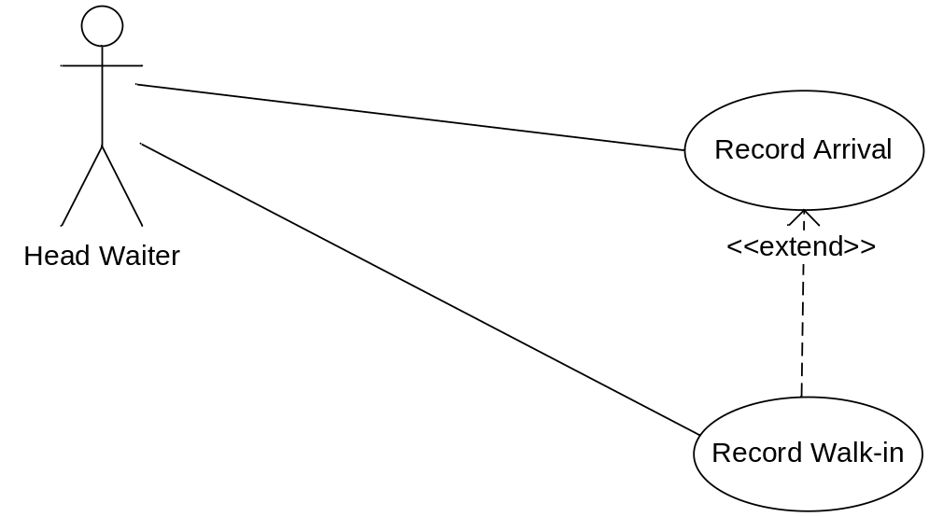
Use case extension
Record Arrival has an alternative flow where there is no booking for a customer and the customer must be booked as a ‘walk-in’
Better to create a separate use case for the extension

Slide 25
Restaurant use cases
Cancel booking : Flow of Events
  The receptionist selects the required booking
  The receptionist cancels the booking
  The system asks the receptionist to confirm the cancellation
  The receptionist answers ‘yes’ and the system records the cancellation and updates the display
Table Transfer: Flow of Events
  The Head Waiter selects the required booking
  The Head Waiter changes the table allocation for the booking
  The system records the alteration and updates the display

Slide 26
Restaurant use cases - final

Slide 27
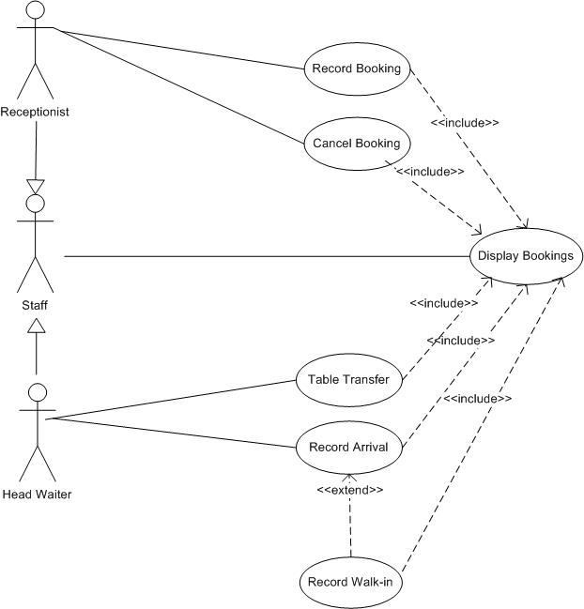
Restaurant use cases - final

Slide 28
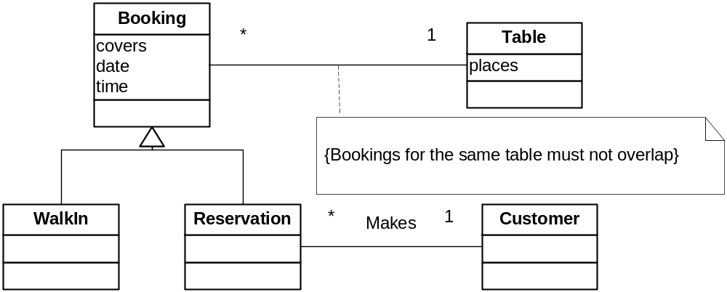
Next – Build a domain model
Class Diagram (more later on this) is a good way
to describe business concepts
= domain model
NB: NOT YET the class diagram for the software, but might have similarities

Slide 29
More examples: Diagram Editor tool
Users create and edit drawings composed of lines, rectangles,
ellipses and text
Tools control the operation of the editor. Exactly one tool is active at a time.
There are 2 kinds of tool: selection tools and creation tools.
  With the selection tool active,
  the user can select drawing elements with the cursor
    More than one element can be selected and manipulated, as if they were one
    The current selection is displayed visually by showing control points for the elements;
    control points can be dragged to change the element shape
  When the creation tool becomes active, there is no current selection
    On creation of an element it becomes the current selection
    Text Element
      The text creation tool changes the cursor to an ‘I’-beam
      and the user can click this on the screen and start typing at that point
      The text creation tool is no longer active once the user clicks outside the text element
      The control points for a text element are its 4 corners – dragging this changes the region

Slide 30
Diagram Editor tool contd
  The creation tools
    Lines, rectangles ellipses
    In these cases the cursor becomes a crosshair
    MouseDown starts to create the object, MouseUp completes it
    MouseDown sets the start point of the element,
    MouseUp the end point
    Line – start point at MouseDown, end point at MouseUp:
    these points are also the control points
    Rectangle – top left point where MouseDown, bottom right point at MouseUp. These points and the other corners become the control points
    Ellipse – draws an ellipse to fit inside the rectangle drawn as with the rectangle tool. The rectangle does not appear, but its corners form control points for the ellipse

Slide 31
Use case diagram
Create Diagram
Use Case diagram summarises all the use cases and actors in the system
Where necessary, scenarios are developed for the use cases
Use-cases are described only in terms of the services they offer to external actors
  The internal details of precisely how this external behavior is to be achieved is represented using logical models e.g. class and object interaction diagrams.
They are not directly object-oriented but already have an ‘object-oriented flavour’
Create Element
Select Element
Move Element
User
Resize Element
Delete Element

Slide 32
Example use case: Create Diagram
Let’s suppose the editor gives the user a workspace within which one diagram can be displayed at a time
On creation of a new diagram this workspace is empty (any existing diagrams are hidden)
Users can choose which diagram to view from those that are open

Slide 33
Flow of events
For each use case identified,
a ‘use case flow of events’ must be documented
This is a step-by-step description,
starting with the actor that initiated the use case,
and ending with the completion of the event
It can be done in continuous prose, OR (better), using a standard template to describe the flow of events
At first only the normal course of events is described,
but as analysis progresses, more detail is added
and alternative flows are included

Slide 34
Flow of events for use case Create Diagram
Flow of Events for the Create Diagram Use Case
Objective | To create a diagram in the workspace
Precondition | -
Main Flow | 1. The user interacts with some user interface component, such as a menu item or a tool bar button, to signal the request to the system 2. The system creates a new diagram object 3. The new diagram becomes the active diagram 4. The editor’s display is updated with the newly created diagram.
Alternative Flows | -
Post-condition | A new diagram is in the workspace and is set as the active diagram

Slide 35
Flow of events for the use case Create New Rectangle
Flow of Events for the Create New Rectangle use case
Objective | To add a new rectangle in the workspace
Precondition | There is an active diagram
Main Flow | The user selects the rectangle tool (if necessary) The user moves the cursor to the required location the user presses the mouse button The user moves the cursor to a new position. A dotted line version of the rectangle appears as the cursor moves. The user releases the mouse button and the new rectangle is displayed
Alternative Flows | -
Post-condition | A new rectangle is visible, with its top left coordinates being those of the MouseDown and the bottom right coordinates being those of the the MouseUp

Slide 36
Flow of events for the use case
Create New Graphical Element
BUT aren’t ellipse creation and line creation very similar to rectangle creation?
  ...about identifying two points
YES – so, let’s use a general version instead: i.e. Graphical Element
Flow of Events for the Create New Graphical Element use case
Objective | To add a new Graphical Element in the workspace
Precondition | There is an active diagram
Main Flow | The user selects the appropriate tool (if necessary) The user moves the cursor to the required location the user presses the mouse button The user moves the cursor to a new position. A dotted line version of the Graphical Element appears as the cursor moves. The user releases the mouse button and the new Graphical Element is displayed
Alternative Flows | -
Post-condition | A new Graphical Element is visible with its top left coordinates being those of the MouseDown and the bottom right coordinates being those of the the MouseUp

Slide 37
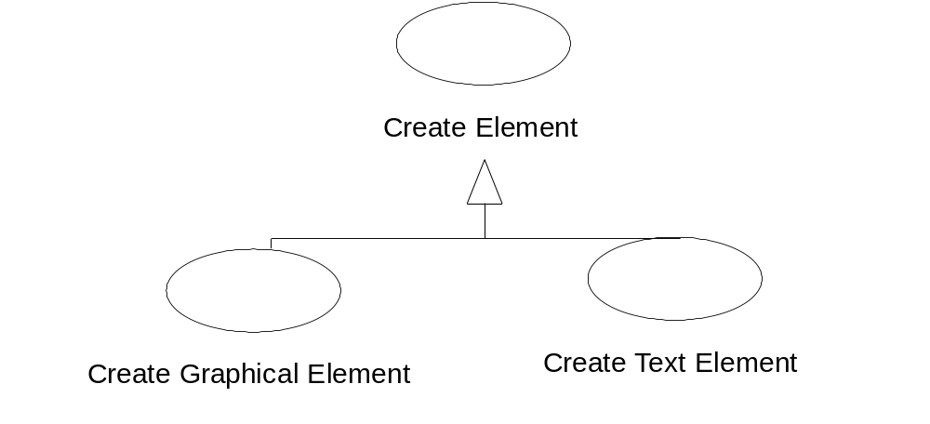
Flow of events for the use case
Create New Text Element
This is different - but it still has some events in common with Create Graphical Element
Create Element is a generalisation
Create Graphical Element and Create Text Element are specialisations of Create Element
In OO terms this is an inheritance relationship

Slide 38
Example use case – Select Element
Flow of Events for the Select Element use-case
Objective | To select an element in the workspace
Precondition | There is an active diagram containing at least 1 element
Main Flow | The user selects the selection tool (if necessary) The user moves the cursor over an element The user presses the mouse button The element becomes selected and the control points are displayed The user releases the mouse button
Alternative Flows | At 3, there may not be an element. In this case no element is selected At 3, the element may already be selected. In this case, it remains selected
Post-condition | The element is selected and its control points are displayed

Slide 39
Example use case – Delete Element
Suppose the user selects an item, then presses a delete button on the keyboard or toolbar
There is only a small bit of extra functionality here
<<include>>
<<include>>
Delete
Delete Element
Select Element
Dashed arrow = UML dependency
<<include>> label indicates the stereotype of the dependency - i.e. that Delete Element includes the use case Select Element
Use include for behaviour that is used by more than one use case, and that is ‘included’ in the flow of those use cases.

Slide 40
Example use case – Move Element
Move Element has a lot of the functionality of Select Element but does more
We can extend a use case
<<extend>>
Move Element
Select Element
The base use case, Select Element, must contain an extension point indicating where the use case Move Element takes over and a condition saying when it should be extended i.e. if the user moves the mouse
Use extends for exceptional or optional behaviour

Slide 41
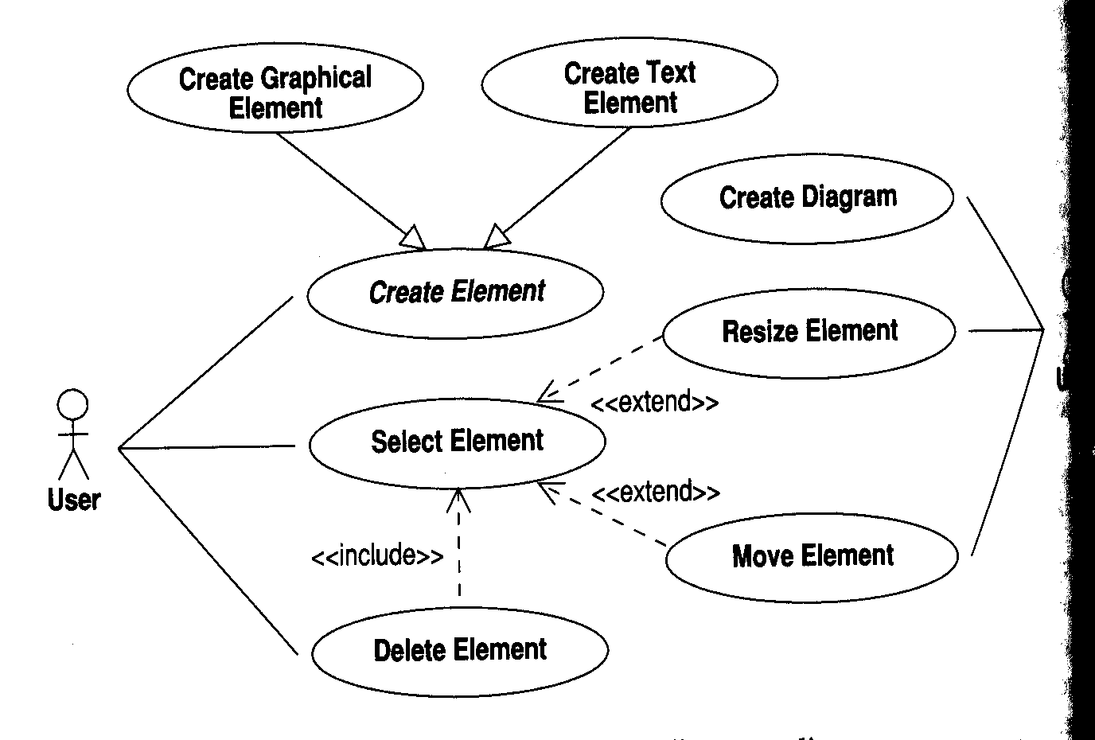
Full use case diagram
Diagram Editor
User
User
[Note: read the dependencies in the direction of the arrow: e.g. Delete Element includes Select Element]

Slide 42
Generalisation between actors
Suppose our diagram tool operates in a shared environment and only Administrators can delete elements
Create Element
Administrator is represented as a specialisation of User and has access to the services of use case Delete Element
User
Select Element
<<include>>
Delete Element
Administrator

Slide 43
Example: Emergency Response system
Report Emergency
Field Officer
Open Incident
Dispatcher
Resource
Allocate Resources

Slide 44
Example: Emergency Response system contd
Use Case | Report Emergency
Actors | Initiated by Field Officer, communicates with Dispatcher
Flow of Events | Field Officer activates the use case Report Emergency. The System responds with a form, which includes an emergency type menu (general emergency, fire, transportation) and fields for location, incident description, resource request and hazardous material. Field Officer completes the form with the emergency type, location and description as a minimum and optionally suggests possible responses and submits the form. The System receives the form and notifies the Dispatcher who sees a popup dialog. Dispatcher reviews the submitted information and creates an Incident in the database using the Open Incident use case. All the input data is included automatically in the Incident. The Dispatcher acknowledges the report by sending a short message to the Field Officer. The System displays the acknowledgement to the Field Officer.
Pre-condition | Field Officer is logged in.
Post- condition | Field Officer receives acknowledgement and selected response from Dispatcher OR Field Officer receives response saying transaction not processed and why.
Non-Functional Requirements | The Field Officer’s report is acknowledged within 30 seconds. The selected response from the Dispatcher arrives in <30 secs with Field Officer.

Slide 45
Example <<include>> & <<extend>>
Open Incident
<<include>>
<<extend>>
Allocate Resources
View Map

Slide 46
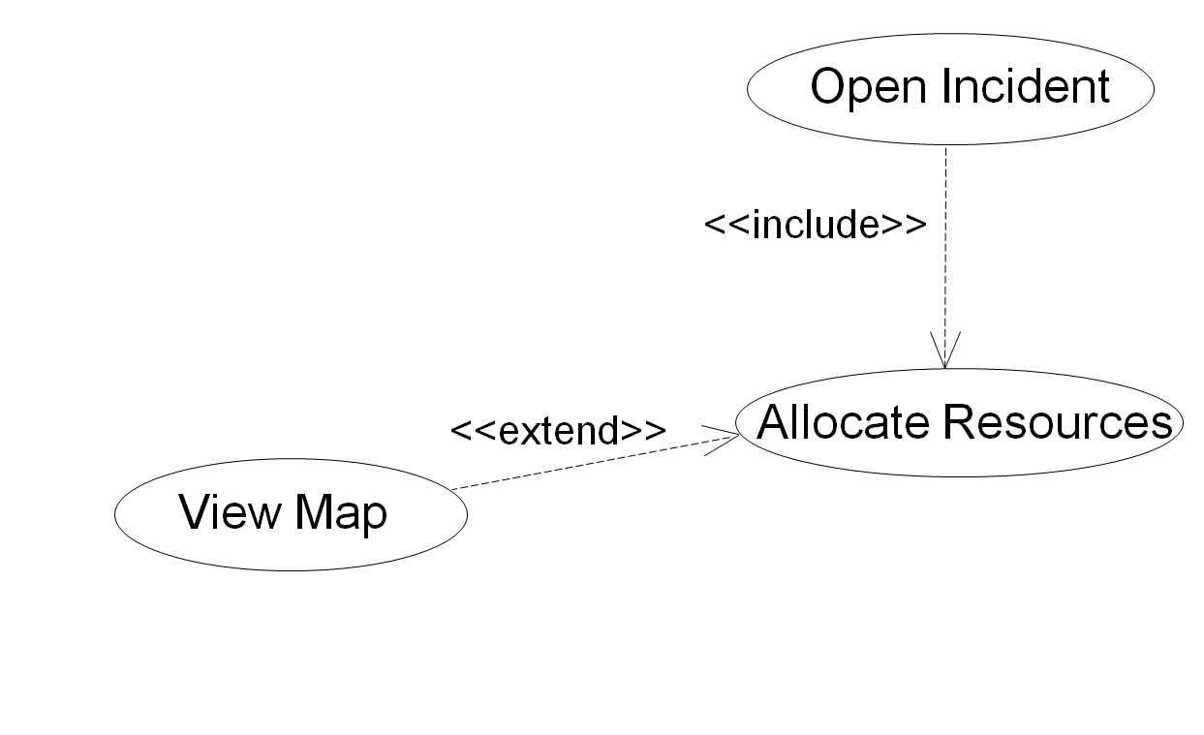
Use case Allocate Resources
Use Case | Allocate Resources
Actors | Initiated by Dispatcher
Flow of Events | … At any point in the flow of events, if the Dispatcher wishes to check the location of an Incident or Resource, the use case View Map may be called.
Pre-condition | Dispatcher opens an Incident.
Post-condition | Resources assigned to Incident. Resources receive notice about assignment. Field Officer in charge of Incident receives notification of new Resources.

Slide 47
Example <<extend>>
OpenIncident
<<extend>>
ConnectionDown
<<extend>>
AllocateResources

Slide 48
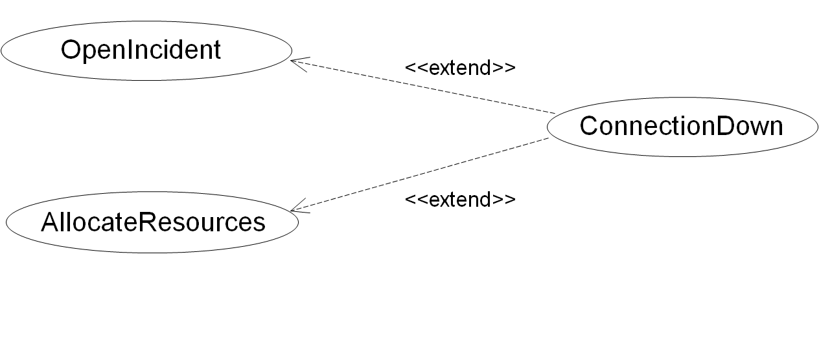
Use case Connection Down
Use Case
Connection Down
Actors
Communicates with FieldOfficer and Dispatcher
Flow of Events
…
Pre-condition
This use case extends the OpenIncident and AllocateResources use cases, automatically initiated if the network connection between FieldOfficer and Dispatcher is lost.
Post-condition
…

Slide 49
Use case guidelines
Use cases are often named with verb phrases: e.g. Open Incident
Actors are Nouns: e.g. Dispatcher
Steps in active voice (subject is the agent of the action)
Describes a complete transaction
Exceptions are separated out (as Alternative Flows or as ‘extends’)
Do not describe the interface in detail
Use extend for optional or exceptional behaviour
Use include for shared behaviour that is always included in some flow
2-3 pages max.
  If the system is large, decompose into smaller use cases

Slide 50
Non-functional requirements
Requirements that define what the system should do are called functional requirements
Non-functional requirements define system properties and constraints
Process requirements may also be specified mandating a particular CASE (computer-assisted software engineering) system, programming language or development method
Non-functional requirements may be more critical than functional requirements.
  If they are not met, the system is useless
Typically:
  Reliability, Security, Availability, Maintainability, Portability, Performance

Slide 51
Example: Satellite Watch
Functional Requirements:
  Displays time based on current location
  Uses GPS satellites to determine position and adjust time for time zone
  2 line display
    Line 1 hh:mm:ss, ttt where ttt =time zone e.g. 10:15:20 GMT
    Line 2: dd:mm:yyyy
  Watch software can be updated via PC/Internet connection (via WebifyWatch Interface)
What are the Non-functional Requirements?
  Usability:
  Reliability:
  Performance:
  Supportability:
  Implementation:
  Implementation :

Slide 52
Example: Satellite Watch
Functional Requirements:
  Displays time based on current location
  Uses GPS satellites to determine position and adjust time for time zone
  2 line display
    Line 1 hh:mm:ss, ttt where ttt =time zone e.g. 10:15:20 GMT
    Line 2: dd:mm:yyyy
  Watch software can be updated via PC/Internet connection (via WebifyWatch Interface)
Non-functional Requirements
  Usability: Any user who has used a digital watch will be able to use it without help
  Reliability: No faults should occur
  Performance: If GPS not available, watch corrects within 5 minutes of it being available again
  Performance: Accurate within 1/100th second over 5 years
  Performance: Correct over all 24 time zones
  Supportability: Accepts upgrades
  Implementation: Java due to company standard
  Implementation : Conforms to WebifyWatch API 2.0

Slide 53
A word on pre & post-conditions
pre-condition (what must be true for the function to execute correctly)
post-condition (what is guaranteed to be true after the function executes)
Example: A merge function may be specified as follows:
merge(item1:array,item2:array): newArray
Pre
  sizeOf(Item1) > 0, sizeOf(Item2) > 0,
  (both arrays have at least one element, 1st element in array has index 0)
  item1[i] < item1[i+1], 0 <= i < noOfItems1 (in order)
  item2[i] < item2[i+1], 0 <= i < noOfItems2 (in order)
Post
  sizeOf(newArray) = sizeOf(Item1) + sizeOf(Item2)
  newArray[i] < newArray[i+1], 0 <= i < sizeOf(newArray)
These are all testable!

Slide 54
Requirements Verifiability
Requirements should be written so that they can be objectively verified
The problem with the following requirement is its use of vague terms such as “errors shall be minimised”:
  The system should be easy to use by experienced controllers and should be organised in such a way that user errors are minimised.
    The error rate should be quantified
  Experienced controllers should be able to use all the system functions after a total of two hours training. After this training, the average number of errors made by experienced users should not exceed two per day.

Slide 55
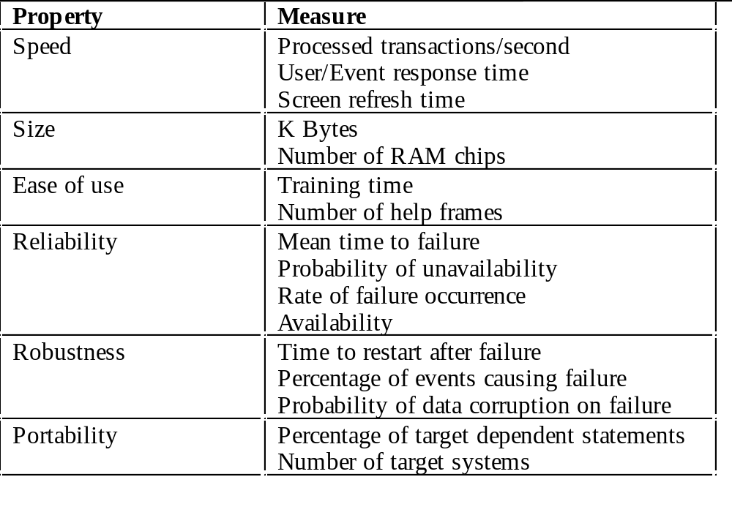
Non-functional requirements measures

Slide 56
Categories of Non-functional Requirements
Usability- ease of learning the system, operating the system and also adherence to users conventions
Reliability – ability of system to perform its functions under stated conditions for a certain time
  Related is robustness (being able to cope with invalid inputs or adverse conditions)
Performance – response time, throughput, accuracy
Supportability – adaptability, maintainability, portability
Implementation requirements – use of language, tools, hardware
Interface requirements – linkage to legacy systems
Operations requirements – constraints on administration and management of the system
Packaging requirements – constraints on how it is delivered (Disk, CD,…)
Legal requirements – licensing, certification, etc

Slide 57
Discussion
Pick one of the following and draw a use case diagram
  (you decide the scope)
  System to manage coursework hand-ins
  System to manage student union services
  System to manage a youth club
  System to support a fantasy football competition
  System to manage student flat/house rentals

Slide 58
Software Engineering
Chapter 4
Requirements Engineering – Use Cases
Objectives
  Be able to define requirements engineering
  Be able to write verifiable functional and non-functional requirements
  Be able to create UML use-case diagrams & descriptions
Text: Priestley Chapter 4 & 5
Bruegge & Dutoit, Chapter 4
Sommerville Chapters 6-8

